Slide 1


CITS1003 Introduction to Cybersecurity [0] Unit overview
Dr Zhi Zhang

Slide 2

Prior to Joining UWA
Ph.D. at UNSW
Research Scientist in Cyber Security at CSIRO, Data61
Research Interests
Operating System Security and Adversarial Machine Learning
https://zhangzhics.github.io

Slide 3
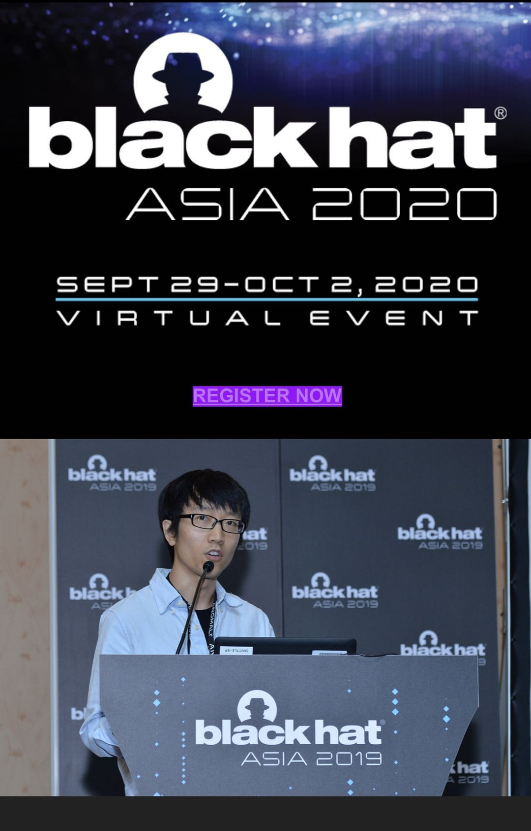

Slide 4

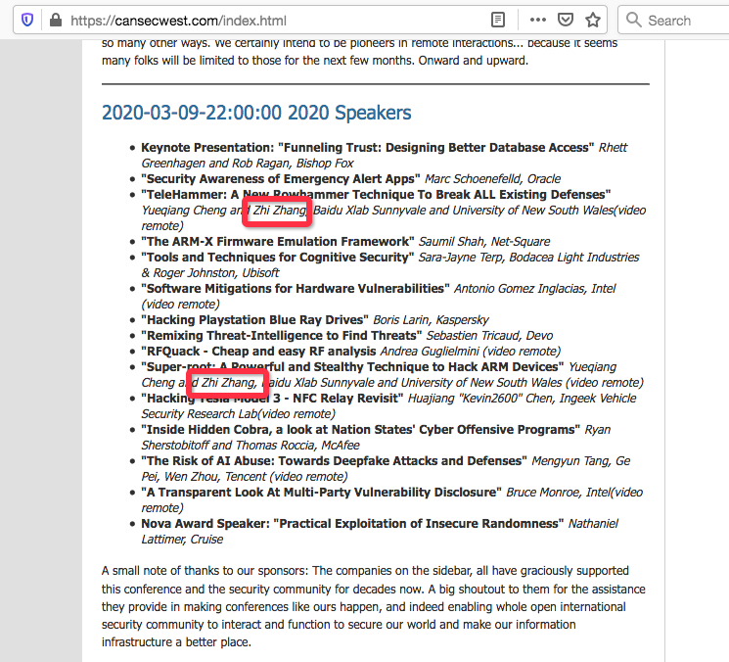
2020

Slide 5
3 Things
Understand the objectives and structure of this unit
01
Understand the technical requirements and role of the practical component
02
Understand the “rules” or ethics of cybersecurity and this unit
03

Slide 6
Pre-Requisites and Target Audience
There are hundreds of students enrolled in the unit from diverse backgrounds
There will be minimal coding (unless you want to do more) in this unit and no assumption of prior knowledge in computer science or mathematics
This is an introductory course and so suitable for anyone wishing to familiarise themselves with the terms, concepts and practical aspects of Cybersecurity
The course is based on CyBOK - the Cybersecurity Book of Knowledge project (https://www.cybok.org/) and some elements of CISSP (Certified Information Systems Security Professional) from ISC²

Slide 7
To Get Started
People
Emergency
Items of assessment
Topics
Ethics
Online resources
FAQs
What is Cybersecurity?
Learning outcomes

Slide 8
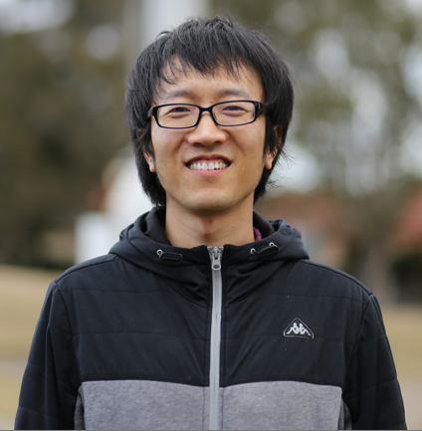
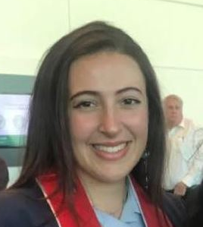
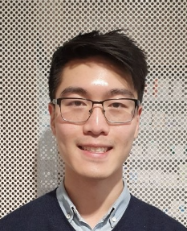

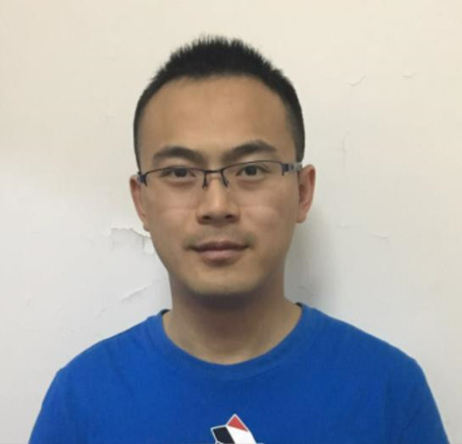
People
Zhi Zhang
Unit coordinator
Room G.10
zhi.zhang@uwa.edu.au
Larry Huynh
Assistant Lecturer
larry.huynh@.uwa.edu.au
Weiyan Xu
Lab facilitator
weiyan.xu@research.uwa.edu.au
Jack Sun
Lab facilitator
23466264@student.uwa.edu.au
Aliah Al-shabib
Lab facilitator
23139394@student.uwa.edu.au
Angus Wise
Lab facilitator
22734222@student.uwa.edu.au
David Adams
Lab facilitator
22497769@student.uwa.edu.au
Hass
School operations team
Room: Main reception
schoolops-pmc@uwa.edu.au

Slide 9
Emergency
General emergency: call campus security at 6488 2222
In super emergency: call emergency at 000
For more details, please have a read through our emergency procedure for various potential incidents
http://www.safety.uwa.edu.au/incidents-injuries-emergency/procedures
For more student services:
https://www.uwa.edu.au/students/Support-services
UniAccess: https://www.uwa.edu.au/students/Support-services/Disability-and-accessibility

Slide 10
Assessments
Lectures
Labs
Project
Final Exam

Slide 11
Lectures
Lectures are presented in a flipped style: watch pre-recorded video lectures of one topic before coming to live lectures.
For video lectures, they are online (all 12 weeks worth of lectures!)
For live lectures, they will be recorded and uploaded into LMS.
We focus on interactive exercises and discussions with exam-style questions included.
Live lectures last around 60-90 mins.

Slide 12
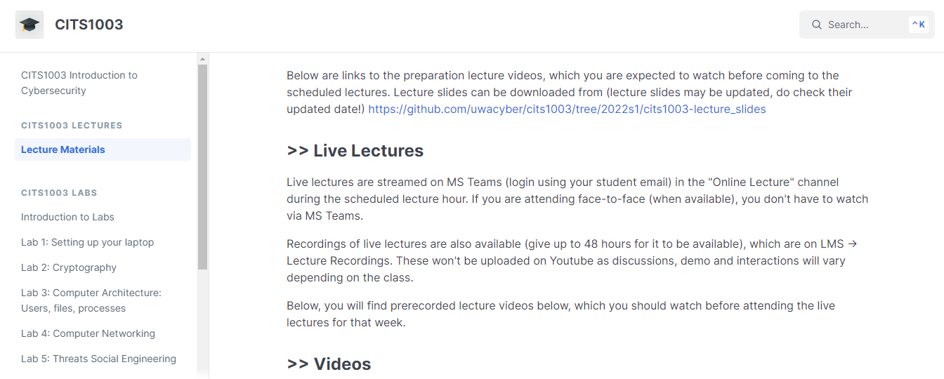
Lectures are available at https://uwacyber.gitbook.io/cits1003/cits1003-lectures/lecture-materials

Slide 13
Labs start in week 1
Lab materials
Lab location
Lab computer
Lab assessment
Lab help
Lab due dates
Lab setup

Slide 14
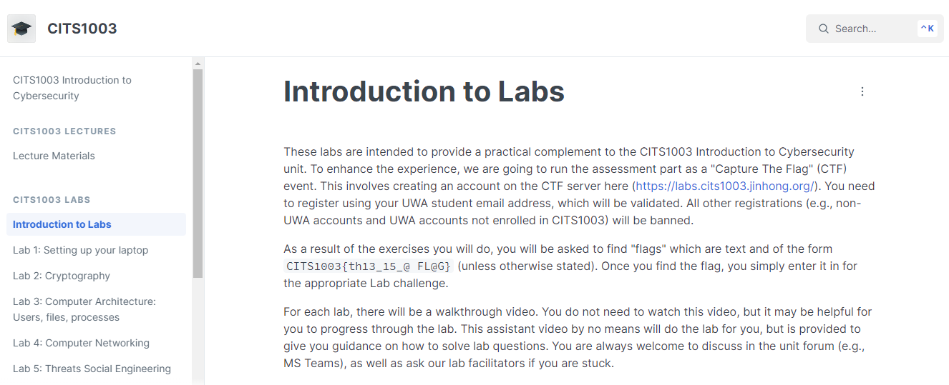
Lab materials are available at https://uwacyber.gitbook.io/cits1003/cits1003-labs/introduction-to-labs

Slide 15
Lab Location
Labs
Labs are in MATH computer lab (https://studentvip.com.au/uwa/main/maps/129665)
Check your timetable for your lab allocation
You may go to another scheduled lab IF there is a room (normally there is)
Log into MS teams when doing labs online

Slide 16
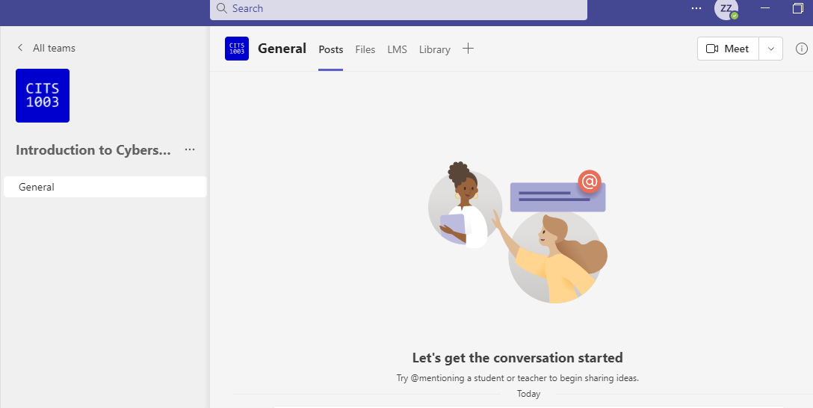
MS Teams

Slide 17
Lab Computer
The labs rely on using a technique called Docker
As docker is NOT available on UWA lab machines, it must be run on your laptops
If you do not have a laptop that is capable of running the labs, you can arrange to borrow one: https://uwacyber.gitbook.io/cits1003/cits1003-labs/introduction-to-labs
Else – invest in a decent laptop – it will make a big difference to your University life.
If none of these options are available to you, please come and chat with me.

Slide 18
Lab Assessment
Labs are worth 25% of assessment.
Each lab is worth of 25 points
10 labs in total are worth of 250 points.
Submission site: https://labs.cits1003.jinhong.org/

Slide 19
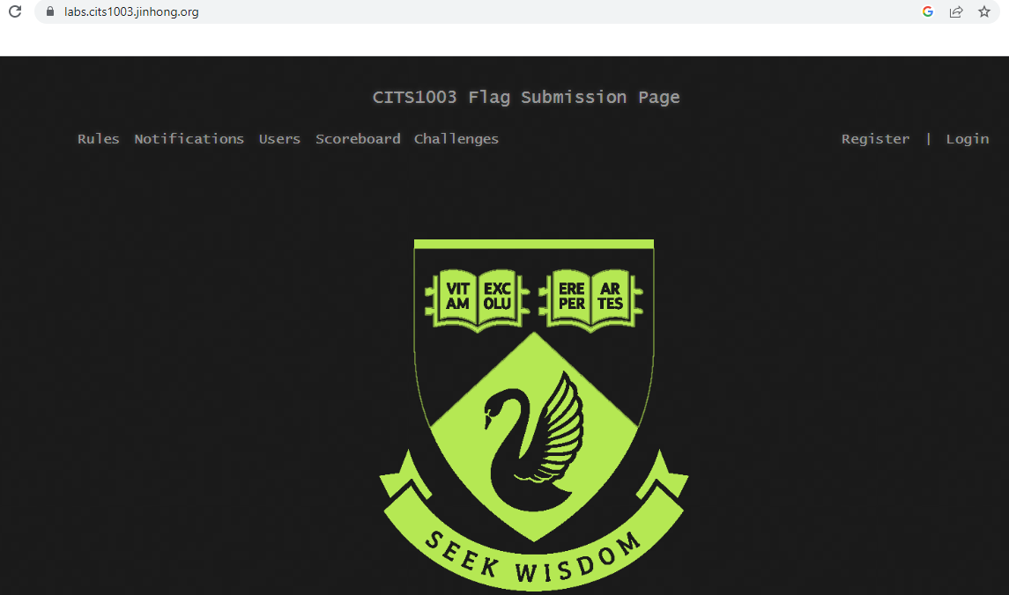
Submission Site
Registration code:uwa{f1r5t_fL4G_4_c1t51OO3!!one1}

Slide 20
Lab Help
For labs, we will be using a help server, which allows students to queue for help
This means no fighting over who put their hands up first
Online students can get noticed
No lab help outside the scheduled lab time

Slide 21
A Help Server
Access the help server at: https://help.jinhong.org/
by default, you use your student ID with temporary password “helloworld”
Any issues logging in, contact any of the facilitators or me
Fill out a form and wait until a facilitator comes to you
Note: for the location, write the desk number for F2F students, and "online" for online students.
If you are doing labs via online, then the facilitator will contact you via Teams

Slide 22
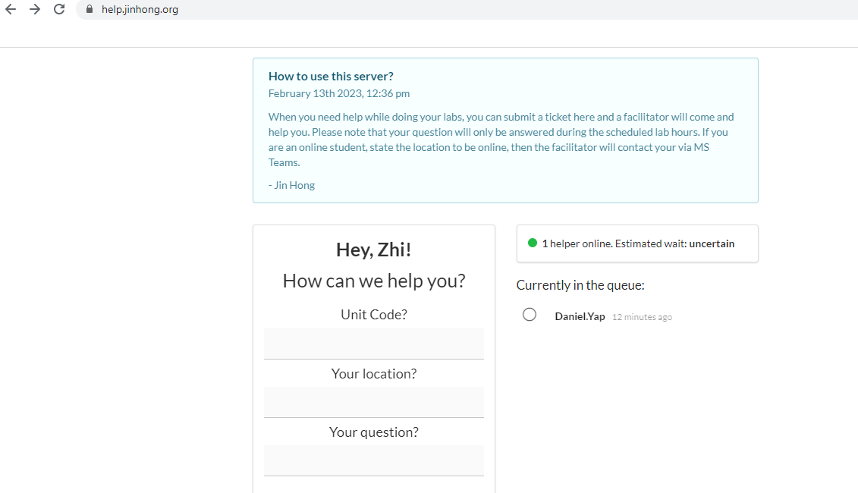
The help server is available at https://help.jinhong.org

Slide 23
Lab Due Dates
For labs 1-3, due date: 5pm 24 March
For labs 4-6, due date: 5pm 14 April
For labs 7-10, due date: 5pm 12 May

Slide 24
Lab Setup
Virtual Machine Manager: Virtualbox or VMware
Setup VM and do labs there to avoid any mistakes propagating to your host
VM provides an additional layer of security.
Not all labs must run in VM (and is safe to do so on your host machine).

Slide 25
Other Assessments
Project will be released in Week 6 (TBC) and ending in Week 10 (TBC). This will be similar in format to the labs – except without the guidance part
Project is worth 25% of assessment
Final Exam: 50% of final assessment
Exam overview will be done in week 12.
Exam can be assisted by open-book notes without electronic materials

Slide 26
Weekly Topics
Introduction to overall definitions and concepts of cyber security
Cryptography: codes and ciphers
Computers and Networks
Threats
Vulnerabilities
Security management
Incidents
Forensics
Critical Infrastructure and Cyber Physical Systems
Cyber Law
AI and Cybersecurity

Slide 27
Enquiries
Office hours
Maybe Friday 12 – 2pm (F2F and virtual ) -> this is just an arbitrary slot
Other times can be arranged too (send an email or message on Teams to book)
Lab Enquiries
Ask on Teams (but remember not to share answers)
Ping lab facilitators (you can contact any one of them)!
If all fails, email me

Slide 28
Online Resources
You may find David's book on Ethical Hacking with Hack The Box useful
https://book.ethicalhackinghtb.xyz/
Other useful online resources will be provided throughout the weeks as necessary.
ChatGPT might be more useful than traditional search engines.

Slide 29
FAQs
Q: Why labs take too long to finish?
A:
Labs are to get you familiar with various cybersecurity concepts, and it could take longer than the allocated 2 hours for the lab to finish it.
You are welcome to attend other scheduled labs (given there are spaces for extra students) to complete the labs with the help of lab facilitators.

Slide 30
FAQs
Q: Why don’t we get sample answers for labs (and others)?
A:
The lab solutions for this unit can be different significantly from one to another, even with reasonably simple questions.
We simply don’t want you to learn sample answers, but rather learn to explore various ways of solving (i.e., improve problem solving skills).
We (facilitators and lecturers) are happy to discuss your solution, work out what might be going wrong and try to fix it with you.

Slide 31

Cheating
Please don’t cheat on any of the assessment items.
Don’t copy your friend’s code.
Don’t copy code from online.
Don’t share your code structure with your friends
Only share ideas
Consequences are dire!

Slide 32
Information Security
All human endeavour relies on information
Business, Government, Education, Research, Personal life
Information security is about protecting this information from “unauthorised access, harm or misuse”¹
This is done by preserving Confidentiality, Integrity and Availability of information

Slide 33
What is Cybersecurity?
Cybersecurity is a subset of Information Security that concerns the digital realm – so:
Cyber security refers to the protection of information systems (hardware, software and associated infrastructure), the data on them, and the services they provide, from unauthorised access, harm or misuse. This includes harm caused intentionally by the operator of the system, or accidentally, as a result of failing to follow security procedures.¹
CIA is sometimes extended to include Authentication, Accountability, Non-Repudiation and Reliability

Slide 34
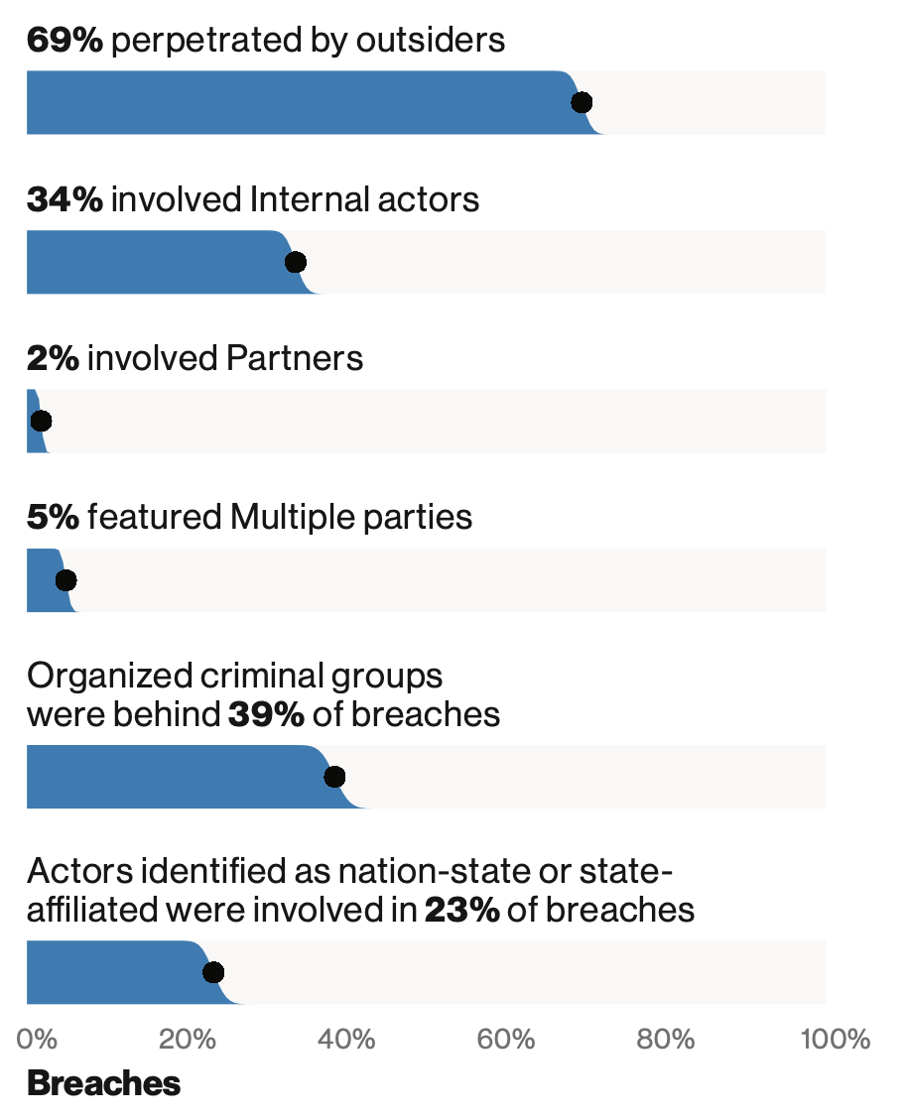
Human Threats
2018 breaches

Slide 35
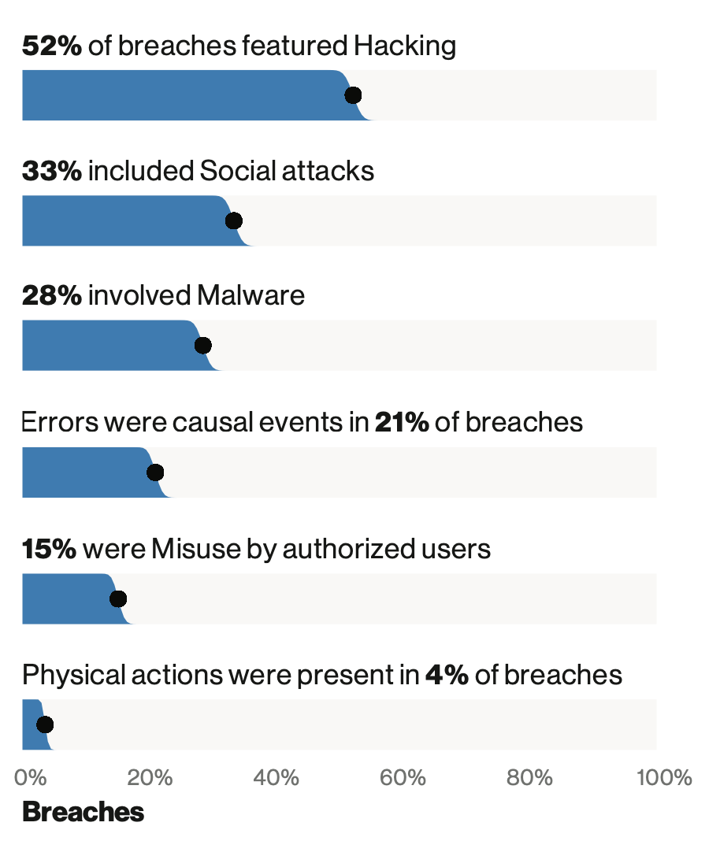
Human Exploits
2018 breaches

Slide 36
Learning Outcomes
To understand and be able to articulate
The language of Cybersecurity
The principles of preserving Confidentiality, Integrity and Availability
Principles of Risk Management
Cybersecurity in the domains of
* Human organisational and regulatory aspects, * Attacks and Defences, * System Security, * Software and Platform Security, * Infrastructure Security
Case studies will be used to illustrate and concretise language, terms and concepts throughout the live lectures
Practical laboratory work will assist in practical aspects of Cybersecurity

Slide 37
Ethics (or what you *absolutely* should not do)
Codes of Ethics are needed by all endeavours that are ”professions”. In cybersecurity, there are several organisations that have them
ISC²
Protect society, the common good, necessary public trust and confidence, and the infrastructure.
Act honourably, honestly, justly, responsibly, and legally.
Provide diligent and competent service to principals.
Advance and protect the profession.

Slide 38
Ethics continued…
Don’t do anything that you don’t have explicit authorisation to do
Hacking without authorization is a crime in almost every country
You can cause damage to yourself and others by being negligent
However that doesn’t stop you exploring, investigating and learning

Slide 39
Copyright notice
Commonwealth of Australia
Copyright Regulations 1969
WARNING
Materials in this unit (CITS1003 – Introduction to Cybersecurity) have been reproduced and communicated to you by or on behalf of The University of Western Australia pursuant to Part VB of the Copyright Act1968 (the Act).
The material in this communication may be subject to copyright under the Act. Any further reproduction or communication of this material by you may be the subject of copyright protection under the Act.

